Slide 1
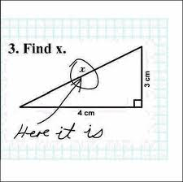
Algebra Comprehensive
September 08, 2011
Today is a B day!
**Don't let this be an answer on your test tomorrow!**

Slide 2
Title: Problem Solving with Pythagorean's Theorem in Two/Three Dimensional Objects.
Date: 09.08.2011
Warm-up:
Use the converse of the Pythagorean's theorem
to determine if the vertices A, B, and C create
a right triangle.
Use the dotted line as a hint!!!

Slide 5
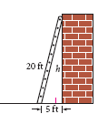

Slide 7
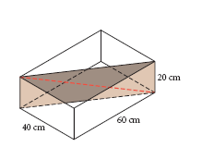

Slide 8
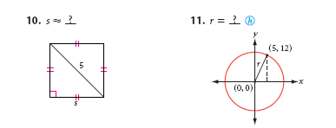

Slide 9
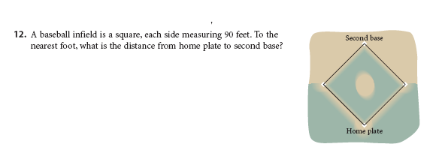

Slide 10
Draw a picture to help!

Slide 11
Homework -
Review Sheet

