Slide 1
Algebra Comprehensive
September 15, 2011
Today is an A day!

Slide 2
Title: Writing Expressions from Patterns Date: 9.15.11
Warm-up:

Slide 3
Review Homework

Slide 4
Patterns and Expressions
What would be the n^{th} term?

Slide 8
Chairs around the table:
Term 1 Term 2 Term 3 Term 4
Questions to consider:
Could this be represented as a table?
What if I wanted to find term 121?
Can this be changed into an expression?

Slide 10
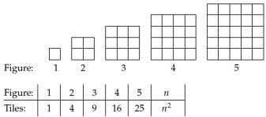
Square Problem:

Slide 11
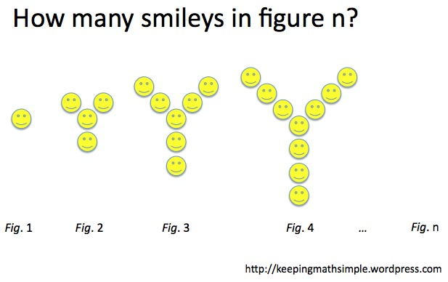

Slide 12
Classwork:
WS - Groups

Slide 13
Homework:
Back of WS

