Slide 1
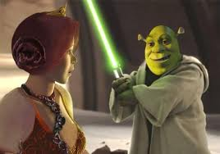
Algebra Comprehensive
September 16, 2011
Today is a B day!

Slide 2
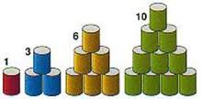
Warm-up:
1.What would the next two terms in the sequence look like?
2. Create a function table for terms 1-6
3. Write an expression to find the n^{th} term.

Slide 3
Weekly Quiz Review
Grade:
8
Subject:
Algebra Comprehensive
Date:
09.16.2011

Slide 4
1
(63 ÷ 4) - 4 × 5 + 3(7-2)
A
49
B
19
C
15
D
53

Slide 5
2
9 + 2(7×3) - 92

Slide 6
3
-43 + (8 × 11) ÷ 4

Slide 7
4
Softball Uniforms Your school softball team has 25 members.
The school contributes $30 toward each $40 uniform. To find how
much money the team needs to raise, evaluate the expression
40 25 - 30 25.

Slide 8
5
A
-39
B
63
C
84
D
96

Slide 9
6
A
5
B
25
C
32
D
50

Slide 10
7
A
2x + y
B
x + 2y
C
3x - 3y
D
2(x + y) - 1

Slide 11
8
A
-15 – 6x
B
6x – 15
C
6x + 15
D
-8 – 5x

Slide 12
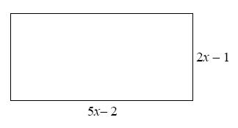
9
A
7x – 3
B
14x – 6
C
10x² −14x +2
D
10x² + 2

Slide 13
10
Solve when n = 3

Slide 14
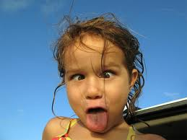
WEEKLY TEST!!!

Slide 15
NO HOMEWORK!

