Slide 1
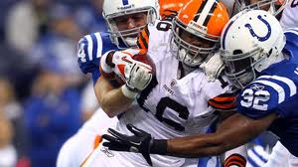
Algebra Comprehensive
September 19, 2011
Today is an A day!

Slide 2
Warm-up:
Write an expression that contains four terms.
One term must be negative.
Another must be an even term with an exponent of 2.
A constant of 6 must be included.
Must have three coefficients of different quantities.

Slide 3
Review Test...

Slide 4
Representations of Algebra
Mathematical Sentence
Function Table
Graph (Coordinate Plane)
In words

Slide 5
Example: 6x + 1

Slide 6
1. -6x + 10
2. 3x² - 1
3. |x + 1|
4. √x + 2
5. x³ + x² + 1

Slide 7
Homework
Pg. 46-47
3-8, 15, 16

