Slide 1
Algebra Comprehensive
September 20, 2011
Today is a B day!

Slide 2
Representations of Algebra 9.20.2011
Warm-up:
Write the following expression as a function table. Afterwards, graph your function table on the coordinate plane.
8x² - 15

Slide 3
Review Homework: Pgs. 46-47 (3-8, 15, 16)

Slide 4
Going from a function table to the rest!

Slide 5
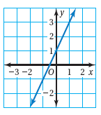
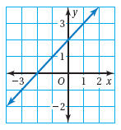
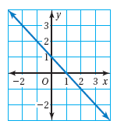
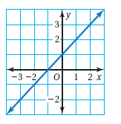
What about from a graph?

Slide 6
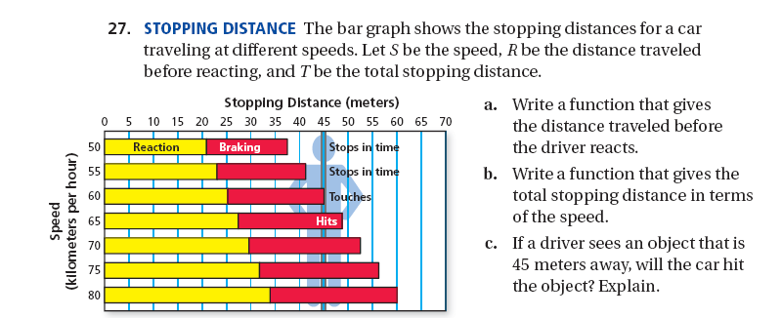
Word Problems!

Slide 7
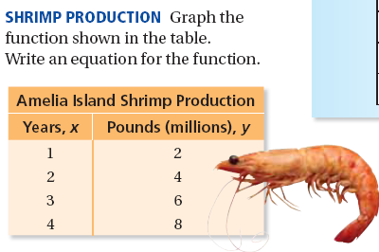

Slide 9
Classwork/Homework
Figuring out the rule WS

