Slide 1
Algebra Comprehensive
September 21, 2011
Today is an A day!

Slide 2
Warm-up: Title: Domain/Range
Change the following graph into a function table. Write the expression for the n^{th} term.

Slide 3
Domain and Range
also known as the independent and dependent variable.
also known as input and output
also known as x and y
A function consists of both where each input is paired with exactly one output!!!

Slide 4
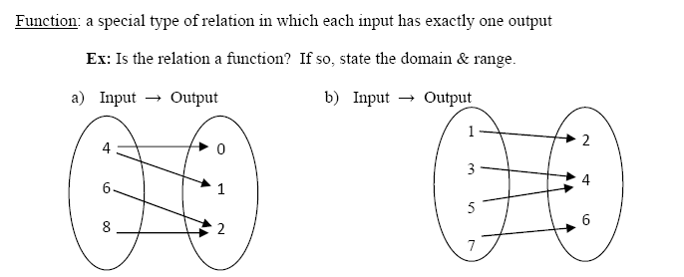
Example:
MAPPING DIAGRAMS

Slide 5
Let's change the first mapping diagram into a table...

Slide 6
And the second one...

Slide 7
What if they were graphed?

Slide 8
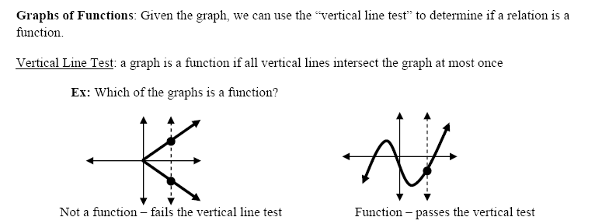

Slide 10
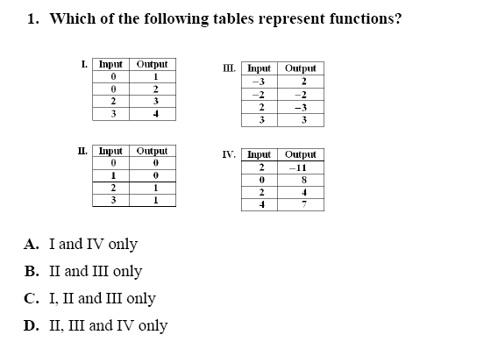

Slide 11
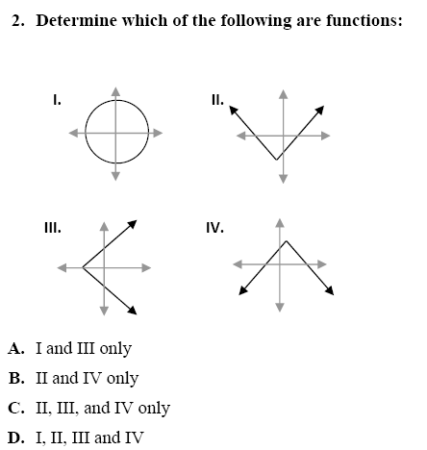

Slide 12
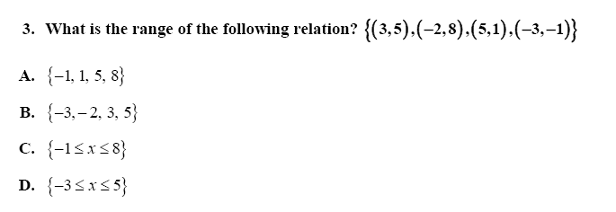

Slide 13
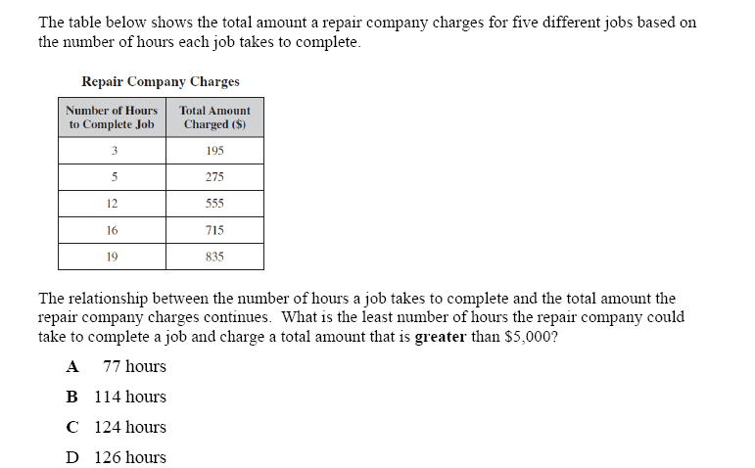

Slide 14
Open to pg 35 in your book...
Example Problems

Slide 15
Homework:
Pgs. 38-40
4, 8, 12, 19, 20, 24, 28

