Slide 1
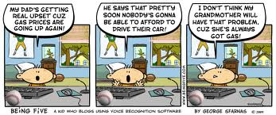
Algebra Comprehensive
September 22, 2011
Today is a B day!

Slide 2
Warm-up:
You pay $50 to attend a dance camp. You pay $5 for transportation each day. Create a function table to show the amount you would pay to attend camp for 10 days.
Write an expression to find the amount you would spend to be there for thirty days.
Would this situation represent a function? If so, identify the domain and range.

Slide 3
Review homework!!

Slide 4
Test Day!!!!

Slide 5
NO HOMEWORK!!!

