Slide 1
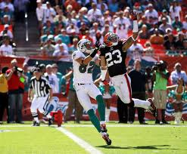
Algebra Comprehensive
September 26, 2011
Today is an A day!
BROWNS WIN!

Slide 2
Title: Linear/Non-Linear Data Date: 9.26.11
Warm-up:
How can you determine if a graph is a function?
How about a function table?

Slide 3
Group Task Cards:
·Every group must complete the assigned task cards.
·Each group must work on the same task card.
·Your group will be graded on
· Mathematical Discussion
· Group Involvement
· Questioning by Teacher
· Correctness

Slide 4
Review Task Cards

Slide 5
Homework:
WS

