Slide 1
Welcome to the Matrix

Slide 2
A matrix is a rectangular arrangement of numbers split into rows and columns.
0 4 -1
-3 2 5
A =

Slide 3
If a matrix has m rows and n columns, the dimensions or order of the matrix are written as m x n.
0 4 -1
-3 2 5
A =
2 rows
(m,n)
3 columns

Slide 4
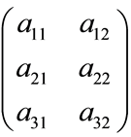
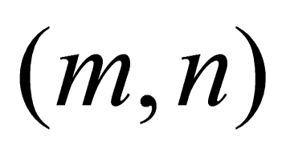
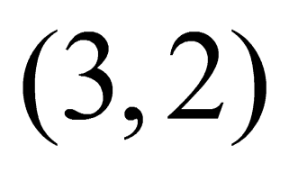
m-by-n matrix
TOUCH
m rows
n columns
TOUCH

Slide 5
Each number in a matrix is called an element or entry. In Matrix A, the element in the first row and second column is 4.
0 4 -1
-3 2 5
a₁₂ = 4
A =
First Row
Second Column

Slide 6
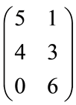
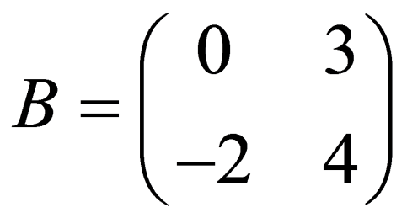
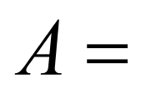
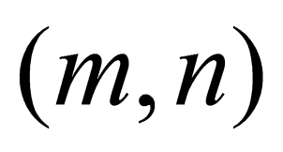
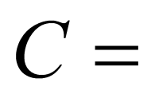
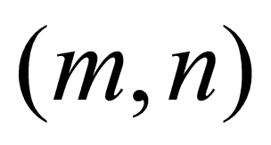
Complete the order of each Matrix

Slide 7
Matrix Addition and Subtraction
To add and subtract matrices, you add or subtract corresponding elements.
*You can only add or subtract matrices that have the same dimensions.*
0 7 -4
-2 9 -3
5 -2 4
0 -5 6
+
=

Slide 8
Matrix Addition and Subtraction
Try:
4 5
3 -6
-1 2
3 2
-3 3
0 -2
-
=

Slide 9
Adding and subtracting matrices
A + B = C
To add or subtract matrices, they must have the same number of rows and the same number of columns. They must be of identical order.
Add each element of the first matrix to the
corresponding element of the second matrix.

Slide 10
Adding and subtracting matrices
These two matrices can not be added
together, as they are not of the same order.
C is (4,1) and D is (1,4).
C + D = E
+
=
To add or subtract matrices they must have the same number of rows and the same number of columns. They must be of identical order.
What do you notice about this problem?

Slide 11
Perform the following matrix operations
C + D = E
+
=
R - S = T
- =

Slide 12
Using matrices to solve problems
The number of singles and albums downloaded from two
online digital media stores, U-tunes and Z-tunes, were recorded
in a matrix (numbers given are in millions of downloads).

Slide 13
Find the total number of singles and total number of albums sold by each company from 2007 to 2009
Double click into the parentheses for the matrix.
Four boxes will appear. Use the keyboard to
enter values for each element of the matix.
Sales from
2007 to 2009

Slide 14
Use the matrix to answer the questions
Which company sold the most single downloads?
Z-tunes
Which company sold the most album downloads?
U-tunes

