Slide 1
Algebra Comprehensive
November 4, 2011
Today is an B day!

Slide 2
Warm-up:
Evaluate by elimination
1. 9x - 3y = 20
3x + 6y = 2
2. 3x + 5y = 19
4x - 8y = -4

Slide 3
Warm-up:
Evaluate by elimination
1. 9x - 3y = 20
3x + 6y = 2

Slide 4
2. 3x + 5y = 19
4x - 8y = -4

Slide 5
Review Homework

Slide 8
Team Activity:
·Teams have already been formed. Each individual is responsible for contributing to the group assignment.
·Teams will receive one grade as a whole.
·Write all answers on the answer sheet. I recommend each person has a scrap sheet.
·The assignment is due at the end of class.
·Mrs. Junge and I will be walking around the room to assist any teams who are struggling. All individuals in the team must not know the answer to the question before calling a teacher over.

Slide 9
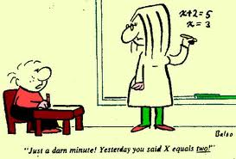
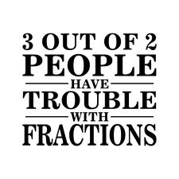
Test

