Slide 1
Algebra Comprehensive
November 09, 2011
Solving Multi-Step and Compound Inequalities

Slide 2
Warm-up:
Write the sentence as an inequality, then solve the inequality and graph its solution.
1.) The product of 8 and x is greater than 50.
2.) The quotient of v and -9 is less than -18.
3.) r < 1.8
30

Slide 3
1.) The product of 8 and x is greater than 50

Slide 4
2.) The quotient of v and -9 is less than -18.

Slide 5
3.) r < 1.8
30

Slide 6
Review Homework

Slide 7
Solving Multi-Step Inequalities:
Solving multi-step equations has the same steps to solving multi-step inequalities, except for the property we learned yesterday.
Example 1: 3x - 7 < 8 Graph your Solution.

Slide 8
Example 2: -0.6(x - 5) ≤15

Slide 9
You try!
1.) 2x - 5 ≤ 23
2.) -6y + 5 ≤ -16
3.) -¼(p - 12) > -2

Slide 10
Example 3: 6x - 7 > 2x + 17

Slide 11
If an inequality is equivalent to an inequality that is true, such as -3 < 0, then the solutions of the inequality are ALL REAL NUMBERS. If an inequality is equivalent to an inequality that is false, such as 4 < -1, then the inequality has NO SOLUTION.
Example 4: 14x + 5 < 7(2x - 3)
Example 5: 12x - 1 > 6(2x - 1)

Slide 12
You try!
4.) 5x - 12 ≤ 3x - 4
5.) 5(m + 5) < 5m + 17
6.) 1 - 8s ≤ -4(2s - 1)

Slide 13
Example 6: You are saving money for a summer camp that costs $1800. You have saved $500 so far, and you have 14 more weeks to save the total amount. What are the possible average amounts of money that you can save per week in order to have a total of at least $1800 saved?

Slide 14
Compound Inequality: consists of two separate inequalities joined by and or or.
Graphs joined with and Graphs joined with or
x > -2
x ≤ 1
and/or

Slide 15
Example 1:
Translate the verbal phrase into an inequality. Then graph the inequality.
a.) All real numbers that are greater than -2 and less than 3.
b.) All real numbers that are less than 0 or greater than or equal to 2.

Slide 16
You try!
1.) All real numbers that are less than -1 or greater than or equal to 4.
2.) All real numbers that are greater than or equal to -3 and less than 5.

Slide 17
Solving Compound Inequalities:
Example 2:
2 < x + 5 < 9 Graph your Solution.

Slide 18
Example 3:
-6 < 3n + 9 < 21

Slide 19
Example 4:
-5 ≤ -x - 3 ≤ 2

Slide 20
Example 5:
2x + 3 < 9 or 3x - 6 > 12

Slide 21
You try!
3.) -7 < x + 5 < 4
4.) -7 < -z - 1 < 3
5.) 4c + 1 ≤ -3 or 5c - 3 > 17

Slide 22
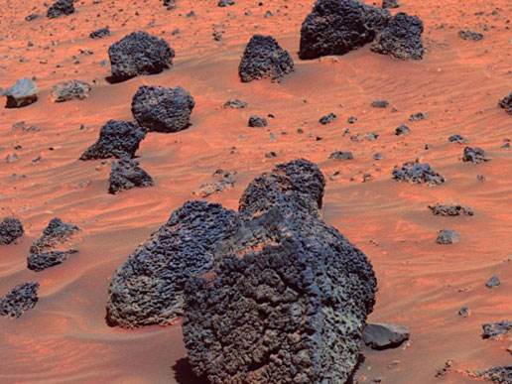
Example 6: The Mars Exploration Rovers Opportunity and Spirit are robots that were sent to Mars in 2003 in order to gather geological data about the planet. The temperature at the landing sites of the robots can range from -100℃ to 0℃.
Write a compound inequality that describes the possible temperatures (in degrees Fahrenheit) at a landing site.

Slide 23
Homework:
Pgs. 372-373 (6, 12, 24, and 38)
Pgs. 384 - 385 (4, 12, 14, 23, and 37)

