Slide 1
Comprehensive Algebra
Solving Inequalities with two variables
November 15, 2011
Today is a B day

Slide 2
Solving two variable Inequalities
November 15, 2011
Warm Up
Put the equations in slope intercept form and determine if (0,0) is a solution
1. 3x + y = 9
2. x + 4y = -8
y = mx + b

Slide 3
1. 3x + y = 9

Slide 5
2. x + 4y = -8

Slide 6
Go over Homework and Test
Homework: Pgs. 384 - 385 (4, 12, 14, 23, and 37)

Slide 9
Solving inequalities with two variables
Who Lives Where Activity
On your graph paper
1. Turn the paper sideways.
2. Draw the x-axis and y-axis
3. Scale each axis with integers, having each square be 1/2

Slide 10
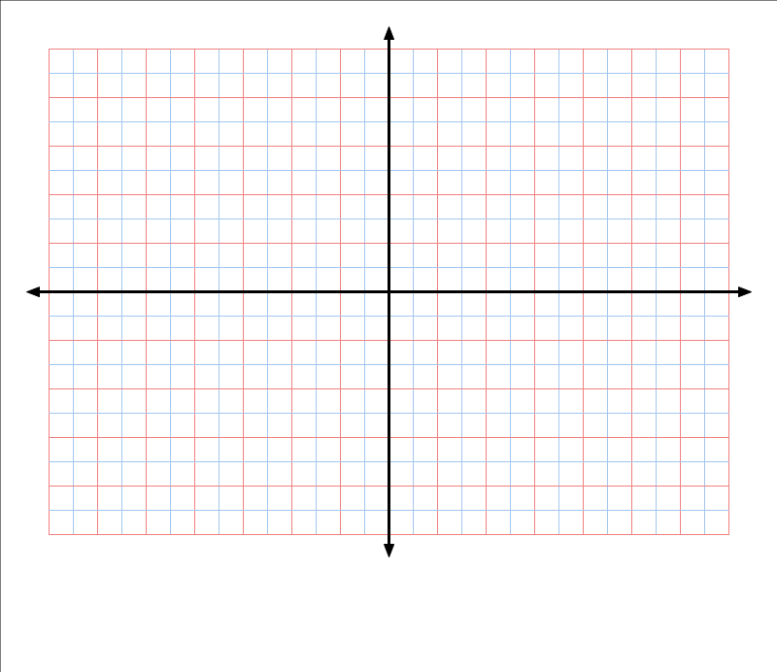
Label Axis and Scale

Slide 11
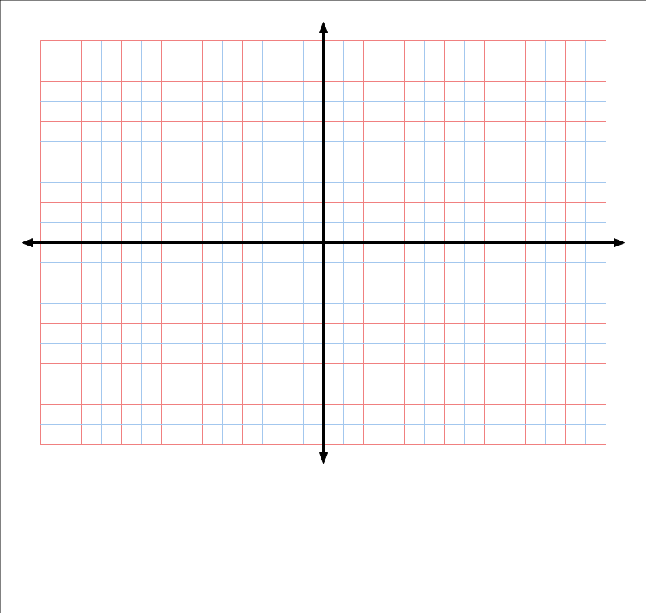
Tundra Lane: Y= 2x -1
Draw Other Lines

Slide 12
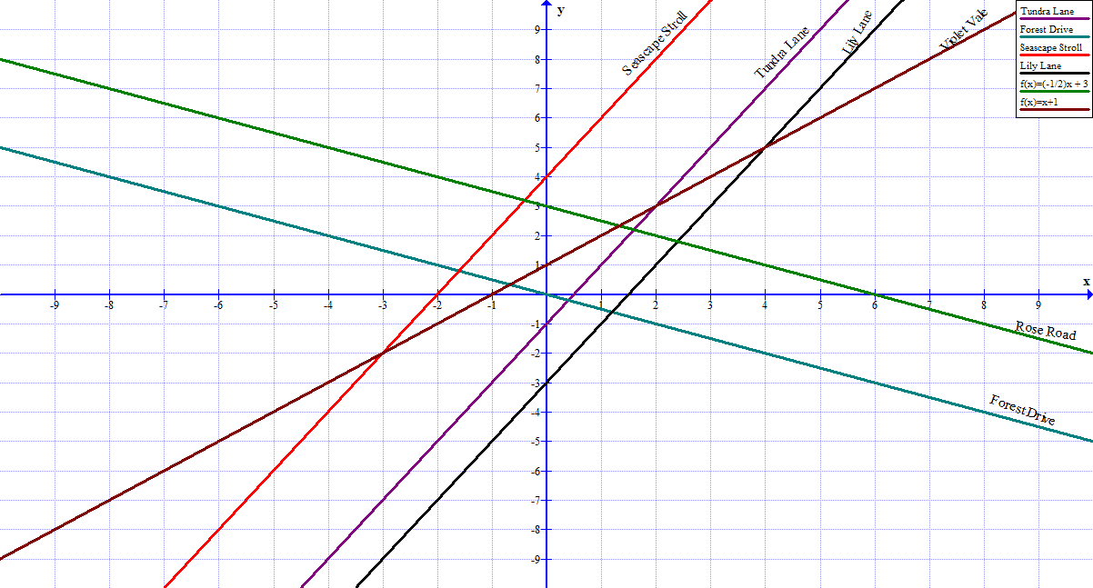
Where do the apes live?

Slide 13
Shading in Each Area

Slide 14
Identify the animals that live at the following points.
a. (1,0)_____________________

Slide 15
Homework: Page 409
problems 3 - 11

