Slide 1
Comprehensive Algebra
Solving Inequalities with two variables
November 16, 2011
Today is an A day

Slide 2
Warm UP
Solving Inequalities with two variables
November 16, 2011
1. -2x -2y = 10
2. x + y > -8
A. Put the equation and inequality in slope intercept form.
B. What is the slope?
C. What is the y-intercept?

Slide 3
1. -2x -2y = 10
2. x + y > -8

Slide 4
Go over Homework
Homework: Pg. 409 (Problems 3 - 11)

Slide 6
Solving Inequalities with two variables
What we know so far:
Boundary lines
Whole area is a solution
How to determine if ordered pair is a solution

Slide 7
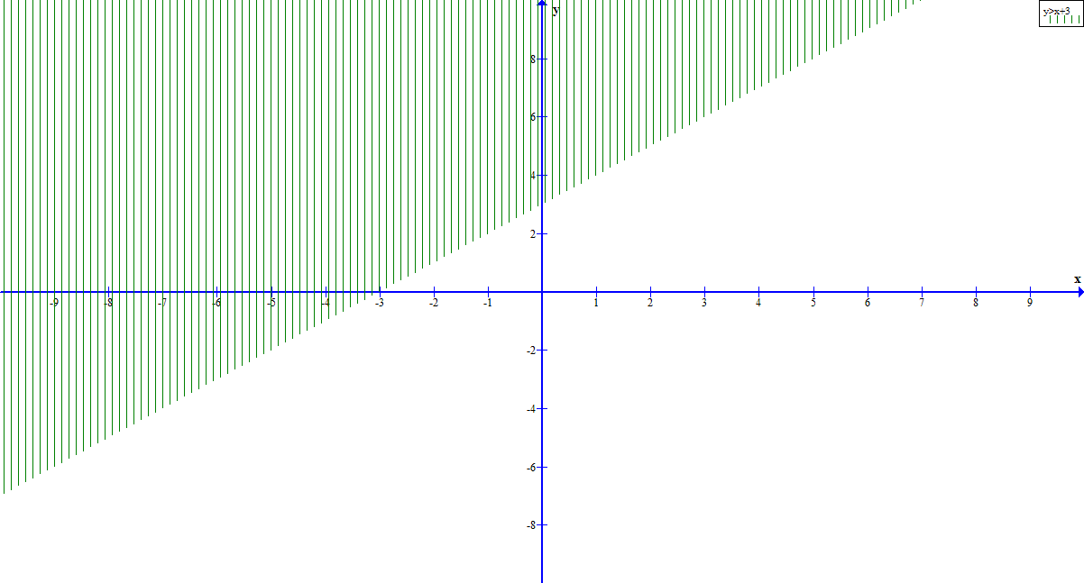
Example: for y > x + 3

Slide 8
Steps to solving linear inequalities with two variables
1.) Put inequality in slope intercept form
2.) Graph boundary line using y-intercept and slope
3.) Decide whether line is dashed or solid
if it is < or > line will be dashed
if it is
or
line will be solid
4.) Plug in a test point
try (0,0) if not on line
5.) Based on if test point is a solution or not, shade in
graph.

Slide 9
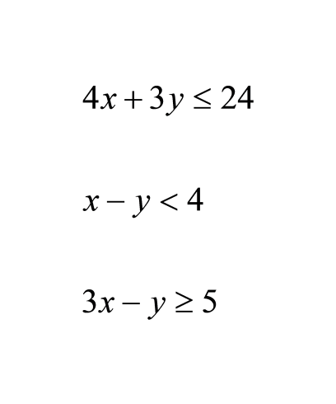
Put in slope intercept form

Slide 10
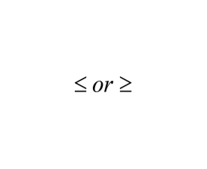
To determine boundary line
1. Put inequality in slope intercept form
4. If inequality is < or > line will be dashed
5. If inequality is
2. Use y-intercept to graph first point
3. Use slope to determine second point of line
line will be solid

Slide 11
-3y -2x < 12

Slide 12
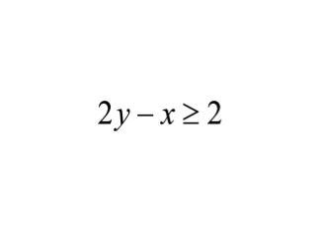

Slide 13
Boundary Line Activity
1. Each group will be given a linear inequality
2. The group should:
A. Write the linear equality in slope
intercept form.
B. Graph the linear inequality
boundary line.
C. Explain to the class how you determined
the boundary line.

Slide 15
Testing to see if ordered pair is a solution of the inequality
1. Plug in x and y
2. See if inequality is true
Example: Is (0,0) a solution to the inequality
x - 3y
6

Slide 16
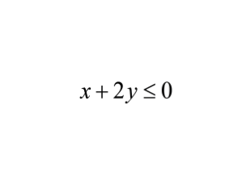
Is (1,0) a solution in
?

Slide 17
You try:
Test to see if these ordered pairs are in the solution to the inequalities
1. x + y < -4; (0,0)
2. y -x > -2; (-1, -4)
3. 4x - 7y > 28 (-2, 4)

Slide 18
(0,0) is the easiest point to check as long as it is not on the boundary line
As a group:
1. Check to see if (0,0) is a solution of the inequality.
2. Shade above or below the boundary line based on this.
3. Explain to the class how you determined where to shade the graph.

Slide 19
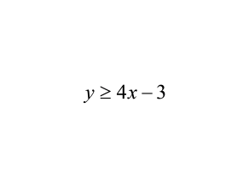
Graph the inequality
1. Put in slope intercept form

Slide 20
2. Graph y-intercept and use slope to determine additonal point
3. Determine if line is dashed or solid
4. Test a point to determine region to shade
5. Shade solution area of graph

Slide 21
7.) x + y > 3
Graph the inequality on your worksheet
1. Put in slope intercept form

Slide 22
2. Graph y-intercept and use slope to determine additonal point
3. Determine if line is dashed or solid
4. Test a point to determine region to shade
5. Shade solution area of graph

Slide 23
As a group:
Graph the inequality 8.)
step 1:

Slide 24
step 2:
step 3:
step 4:
step 5:

Slide 25
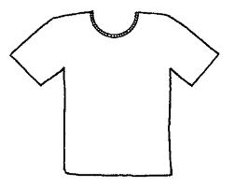
Example 1:
A party shop makes gift bags for birthday parties. They charge $4 per glow stick placed in the bag and $10 per T-shirt. Let x represent the number of glow sticks and y represent the number of T-shirts. The goal is to earn at least $500 for the bags.
1. Write an inequality that describes the goal in terms of x and y.
2. Graph the inequality.
3. Give three possible combinations of pairs of items that will allow the shop to meet its goal.

Slide 26
Write an inequality that describes the goal in terms of x and y

Slide 27
Graph the inequality.
Give three possible combinations of pairs of items that will allow the shop to meet its goal.

Slide 28
Example 2:
You have two summer jobs at a youth center. You earn $8 per hour teaching basketball and $10 per hour teaching swimming. Let x represent the amount of time (in hours) you teach basketball each week, and let y represent the amount of time (in hours) you teach swimming each week. Your goal is to earn at least $200 per week.
1. Write an inequality that describes your goal in terms of x and y.
2. Graph the inequality.
3. Give three possible combinations of hours that will allow you to meet your goal.

Slide 29
2. Graph the inequality.
3. Give three possible combinations of hours that will allow you to meet your goal.

Slide 30
Homework
Pages 409 - 410
Problems 18, 25, 35, 40, 53

