Slide 5
Algebra Comprehensive
November 18, 2011
Today is an A Day

Slide 6
November 18, 2011
Solve and graph the compound inequalities.
Warm Up
1.-15 < -5p - 10 < 20
2. 2x + 3< 9 or 3x - 6 > 12

Slide 7
Warm Up
1.-15 < -5p - 10 < 20
2. 2x + 3< 9 or 3x - 6 > 12

Slide 8
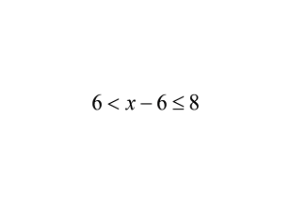
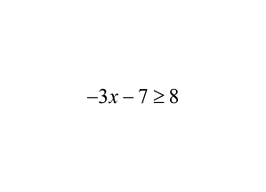
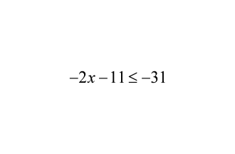
Activity and Homework
Write an inequality that represents the statement and graph the inequality
1. x is less than 8 and greater than 3
2. x is greater than 4 or less than -9
3.
4.

Slide 9
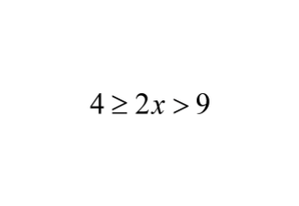
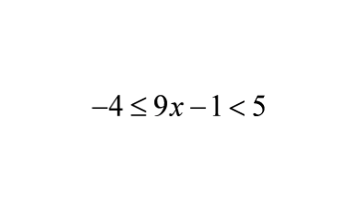
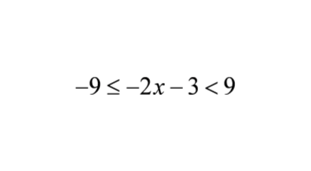
Solve the inequality and graph the solution
5.
6.
7.

Slide 10
8. The table gives the weights of some adult antelopes. The Eland is the largest antelope in Africa. The Royal antelope is the smallest of all. Write a compound inequality that represents the different weights of these adult antelopes
Antelope | Weight (lbs)
Eland | 2000
Kudu | 700
Nyala | 280
Springbok | 95
Royal | 7

Slide 11
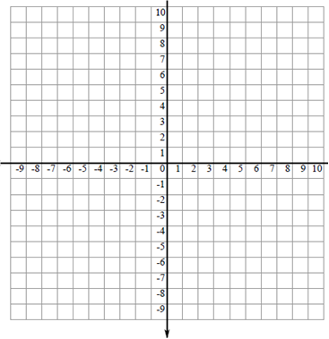
Below is a graph of Julius’ vegetable garden.
Draw and label these additional lines to separate
the vegetables:
9. Dirt Drive: y = 2x -1
10. Fertilizer Freeway: y = -x + 3
11. Label and color the tomatoes which are located :
South of Bird Blvd and East of Dirt Drive
12. Label and color the peas which are located:
West of Fertilizer Freeway and North of Dirt Drive
13. Label and color the corn which is located:
West of Dirt Drive, North of Bird Blvd and
14. What vegetable is located at the following points:
(2, 8)___________________________
(-3, -2) _________________________

Slide 12
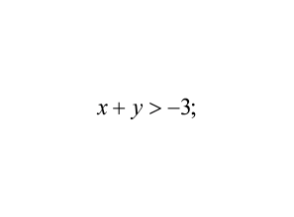
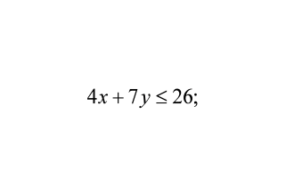
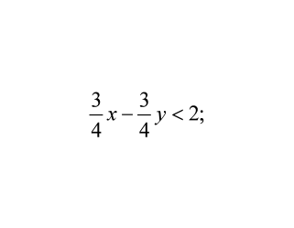
15.
(0,0)
16.
(2,3)
17.
(8,8)

Slide 13
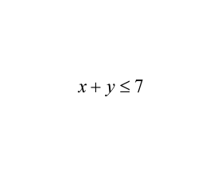
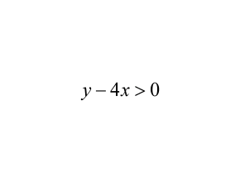
Sketch the graph of the inequality
18.
19.

Slide 14
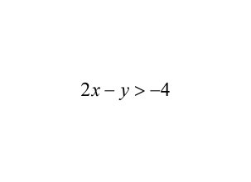
20.

Slide 15
Test Today
7. The sum of -2x and 8 is less than or equal to -5 or -2x is greater than 6

