Slide 1
Comprehensive Algebra
Word Problem Week
November 21, 2011
Today is a B day

Slide 2
November 21, 2011
Applying Compound Inequalities and Two Variable Inequalities to Real Life

Slide 3
November 21, 2011
Applying Compound Inequalities and Two Variable Inequalities to Real Life
Warm UP
A. Decide what you are trying to solve (question being asked).
B. Label the variable(s) and determine what they represent in the following problems.
C. Determine if you will graph on a line graph or a coordinate plane.

Slide 4
1. In 1958, the painting Still Life with Apples by Paul Cezanne sold at auction for $252,000. The painting was auctioned again in 1993, and sold for $28.6 million. Write a compound inequality that represent the different values that the painting probably was worth between 1958 and 1993.
A. What you are trying to solve?
B. What does the variable represent?
C. What Graph should you use?

Slide 5
2. You have $24 to spend on snacks for a party. Cookies are $1.00 per package and brownies are $1.50 per package. Write and graph an inequality to model the amounts of cookies and brownies you can buy.
A. What are you trying to solve?
B. What do the variables represent?
C. What type of Graph?

Slide 6
Go Over Test

Slide 7
Steps to solving word problems:
1. What is being asked?
2. Assign variables for the problem.
3. Write down a mathematical equation or inequality that relates the variables and numbers given in the problem.
4. Compute
5. Check. Is my answer reasonable?

Slide 8
Example 1)
Water can exist as either a solid, a liquid, or a gas. The table shows the temperatures (in degrees Celsius) at which water can exist in each state.
State of Water | Solid | Liquid | Gas
Temperature (C) | Less than 0 | 0 to 100 | Greater than 100
a. Write and solve a compound inequality to find the temperatures at which water is NOT a liquid.
b. Graph the compound inequality.

Slide 9
Example 2)
In 1967 a 60-second television commercial during the first Super Bowl cost $85, 000. In 1998 advertisers paid $2.6 million for two 30-second spots. Assuming those were the least and greatest costs during that period, write an inequality that describes the cost of 60 seconds of commercial time from 1967 to 1998.

Slide 10
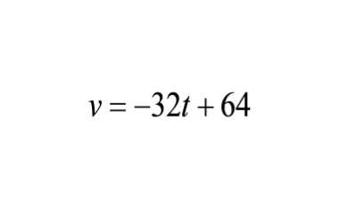
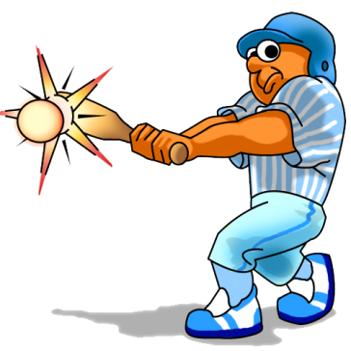
You try
A baseball is hit straight up in the air. Its velocity v (in feet per second) after t seconds is given by:
Find the values of t for which the velocity of the baseball is greater than 32 feet per second or less than -32 feet per second.

Slide 11
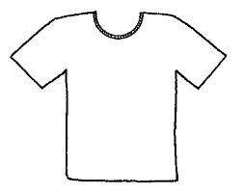
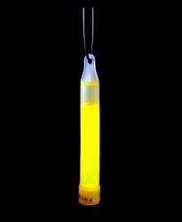
Example 3)
A party shop makes gift bags for birthday parties. They charge $4 per glow stick placed in the bag and $10 per T-shirt. Let x represent the number of glow sticks and y represent the number of T-shirts. The goal is to earn at least $500 for the bags.
1. Write an inequality that describes the goal in terms of x and y.
2. Graph the inequality.
3. Give three possible combinations of items that will allow you to meet your goal.

Slide 12
2. Graph the inequality.
3. Give three possible combinations of hours that will allow you to meet your goal.

Slide 13
Example 4):
You have two summer jobs. You earn $14 per hour babysitting and $7 per hour mowing lawns. Let x represent the amount of time (in hours) you babysit each week, and let y represent the amount of time (in hours) you mow lawns each week. Your goal is to earn at least $140 per week.
1. Write an inequality that describes your goal in terms of x and y.

Slide 14
2. Graph the inequality.
3. Give three possible combinations of hours that will allow you to meet your goal.

Slide 15
You try:
You are going clothes shopping and can spend at most $130 on clothes. It costs $30 for a pair of jeans and $20 for a shirt. Let x represent the number of jeans you can buy. Let y represent the number of shirts you can buy.
A. Write and graph an inequality that describes the different number of jeans and shirts you can buy.
B. Give three possible combinations of jeans and shirts than you can buy.

Slide 17
Homework
page 385 (Problem 38 keep you answer in Celsius)
page 386 (problems 42 and 44)
Page 410 (Problem 54)
Page 419 (Problem 34)

