Slide 1
November 28, 2011
Solving Systems of Linear Inequalities
Today is a B Day

Slide 2
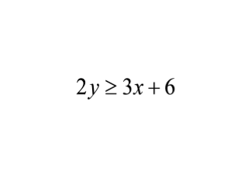
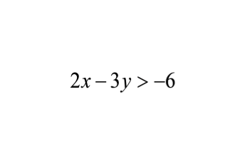
November 28, 2011
Solving Systems of Linear Inequalities
Warm Up
Graph the inequalities
1.
2.

Slide 3
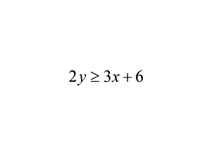
1.

Slide 4
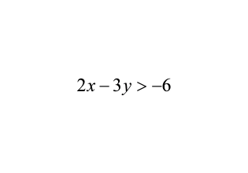
2.

Slide 5
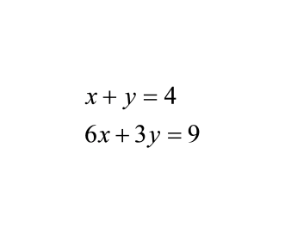
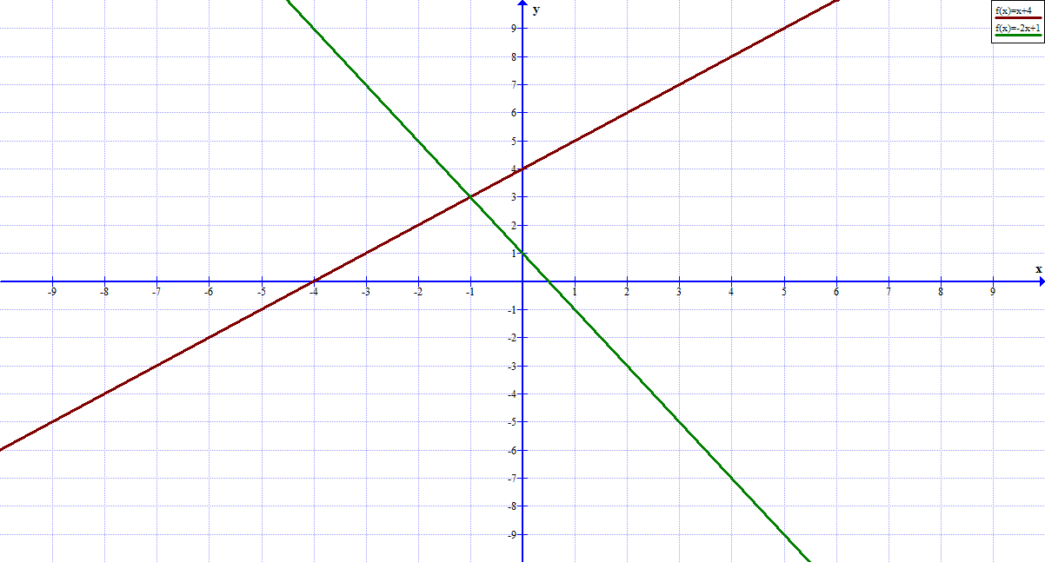
Before we have learned systems of Linear EQUATIONS
The solution is an ordered pair

Slide 7
A system of linear inequalities is 2 or more linear inequalities
A solution is any ordered pair that is a solution in ALL of the inequalities

Slide 8
We need systems of linear inequalities apply to more real life situations:
You have two summer jobs. You earn $14 per hour babysitting and $7 per hour mowing lawns. Let x represent the amount of time (in hours) you babysit each week, and let y represent the amount of time (in hours) you mow lawns each week. Your goal is to earn at least $140 per week.
Also, because of all your sports practices and your chores at home you can only work for at most 18 hours per week.

Slide 9
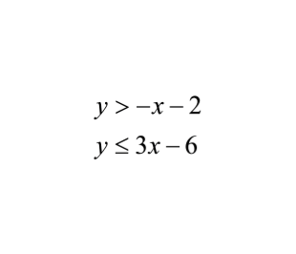
Graphing systems of inequalities
Example 1:
For both inequalities:
1. put in slope intercept form
2. Use a dashed line or solid line.
3. Test a point to decide where
to shade
Where the shading overlaps
is the solution region

Slide 10
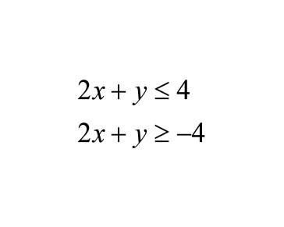
Example 2:

Slide 11
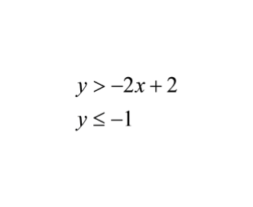
Example 3:

Slide 12
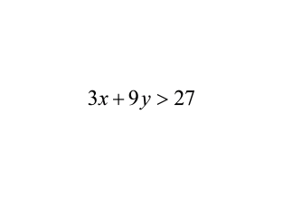
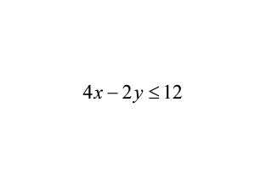
You try.

Slide 13
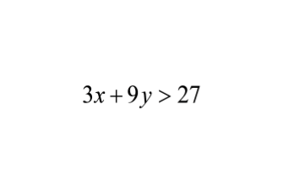
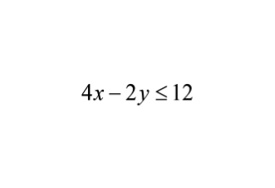
For both inequalities:
1. put in slope intercept form
2. Use a dashed line or solid line.
3. Test a point to decide where to shade
Where the shading overlaps is the solution region

Slide 14
Let's test a point
in each region.
What is the solution?

Slide 15
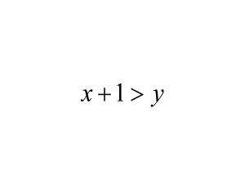
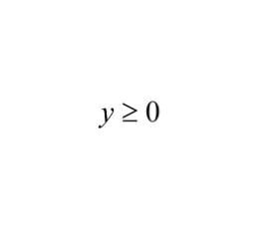
You try.

Slide 16
You try more...
Start working on 2 page worksheet
Solving Systems of Inequalities

Slide 17
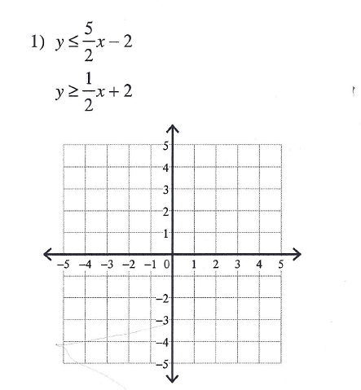

Slide 18
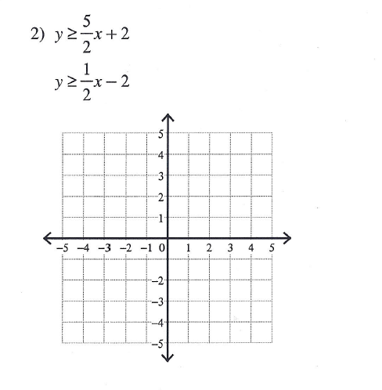

Slide 19
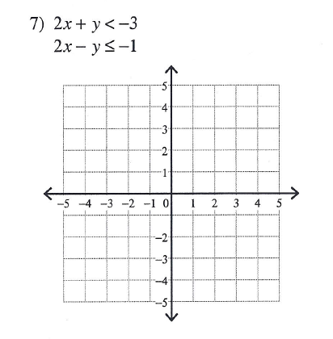

Slide 20
Homework
finish worksheet

