Slide 1
November 29, 2011
Solving Systems of Linear Inequalities
*Determining if an ordered pair is a solution*
Today is an A Day

Slide 2
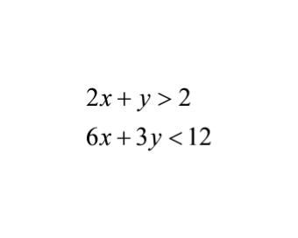
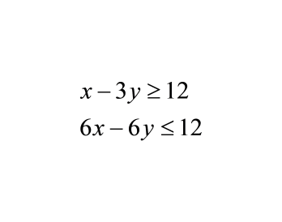
Warm Up
Graph the system of linear inequalities
1.
2.

Slide 3
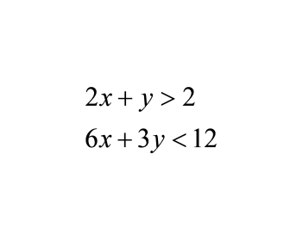
1.

Slide 4
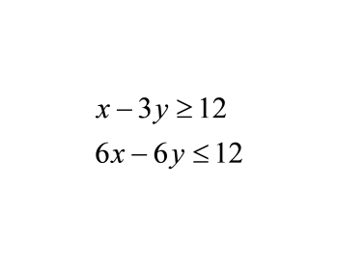
2.

Slide 5
Go Over Worksheet Homework

Slide 6
Identifying if an ordered pair is a solution to the system of inequalities

Slide 7
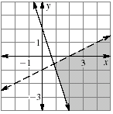
-
Tell whether the ordered pair is a solution of the system of inequalities.
1. (3,0)

Slide 8
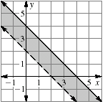
2. (2, 2)

Slide 9
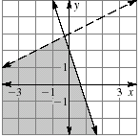
3. (-2, 2)

Slide 10
What if you can't tell if an ordered pair is a solution by the graph?
Example: Determine if (-2,-2) is a solution to the system
y > 3x + 1
y < -x -2

Slide 11
Systems of Linear Inequalities Maze
Use the graph to decide whether each ordered pair is in the solution set.
If you cannot tell from graph, plug the ordered pair into the inequality to check.
Use your answers to find your way to a lettered exit in the maze.

Slide 12
Homework
Page 469
Problems (3, 4, and 5)

