Slide 1
November 30, 2011
Solving Systems of Linear Inequalities
* More than 2 Inequalities*
Today is a B Day

Slide 2
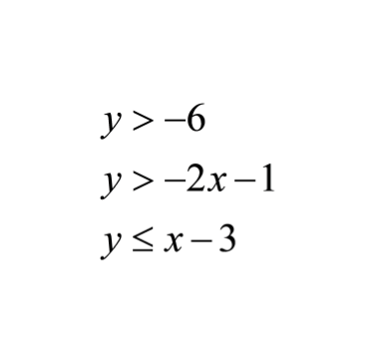
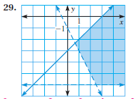
Warm Up
The following system of inequalities is shown with its graph.
1. Name an ordered pair that
is a solution to the system of
inequalities.
Does it look like the ordered pair (2,-5) would be a solution to the system of inequalities?
2.
3. Determine algebraically if (2, -5) is a solution to the system of inequalities.

Slide 3
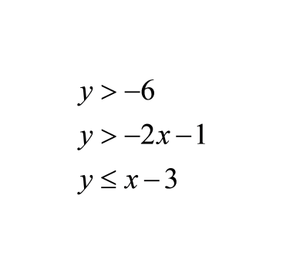

Slide 4
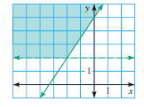
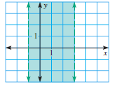
Go Over Homework
Page 469 problems 3, 4, and 5

Slide 5
Graphing a system of inequalities that has more than 2 inequalities

Slide 6
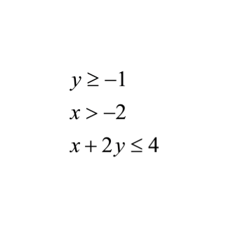
Example 1:

Slide 7
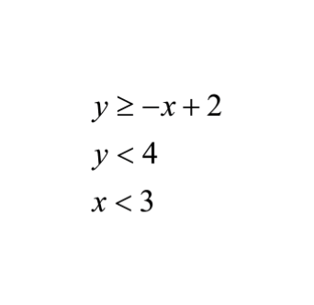
you try Example 2:

Slide 9
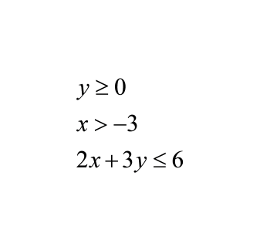
You try Example 3:

Slide 10
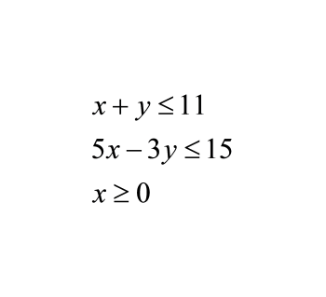
`
Example 4:

Slide 12
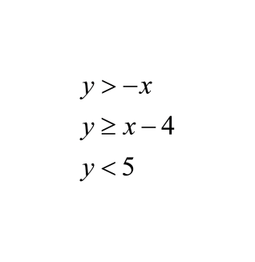
Additional Example:

Slide 13
Treasure Hunt Activity
1. Record the possible locations of the treasure by listing the ordered pairs.
2. Graph the systems of inequalities to determine which ordered pair is located within the solution.

Slide 15
Homework
Page 469 (problems 18 and 20)

