Slide 1
December 12, 2011
Writing Ratios and Proportions
Today is a B Day

Slide 2
Go Over Test

Slide 3
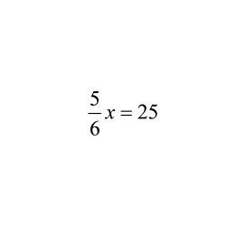
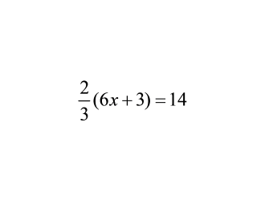
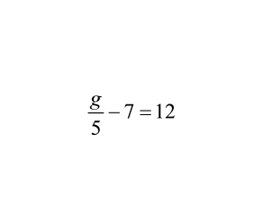
Warm-up
Solve the equation
1.
2.
3.

Slide 4
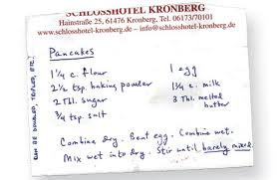
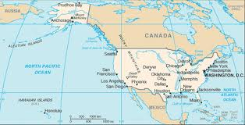
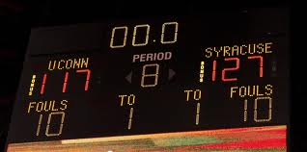
Proportions and Ratios
Examples where we see them

Slide 5
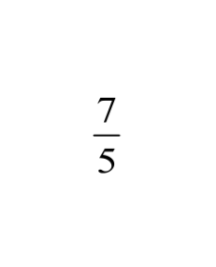
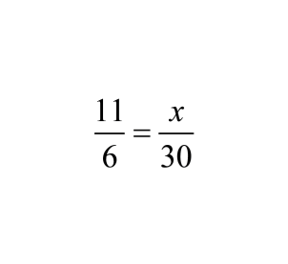
A ratio uses division to compare quantities
Example:
A proportion is an equation that states that two ratios are equal.
Example:

Slide 6
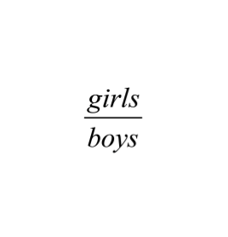
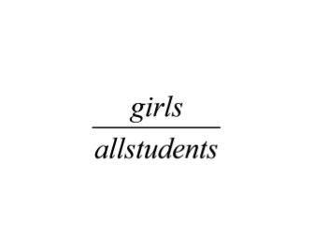
Ratios

Slide 7
Ratio Example 1:
A volleyball team plays 14 home matches and 10 away matches.
1. Find the ratio of home matches to away matches.
2. Find the ratio of home matches to all matches.

Slide 8
You try:
Derek and his brother decide to combine iTunes songs. Derek has 44 songs and his brother has 52 songs. Find the ratios below.
1. The number of Derek's songs to the number of his brother's songs.
2. The number of Derek's songs to the number of songs in the entire collection.

Slide 10
Proportion
Example 2:

Slide 11
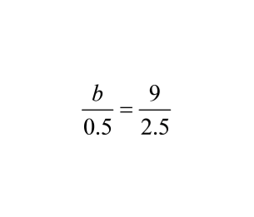
Proportion
Example 3:

Slide 12
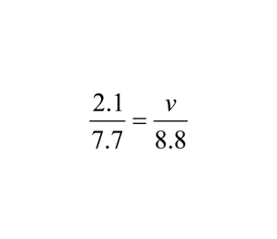
You try:

Slide 13
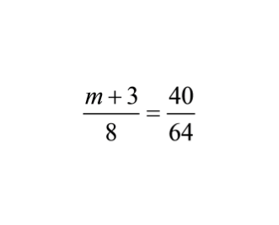
Proportion
Example 4

Slide 14
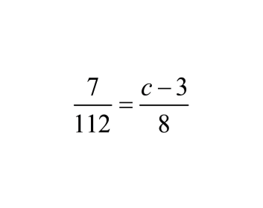
You try...

Slide 15
Proportion
Example 5
Julian ran 2, 5 kilometer races and won 1. Cass ran 4, 3 mile races and won the same proportion that Julian did. How many races did Cass win?

Slide 16
Proportion
Example 5
A recipe for tomato salsa calls for 30 tomatoes to make 12 pints of salsa. How many tomatoes are needed to make 4 pints of salsa?

Slide 17
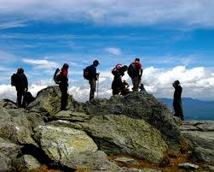
Proportion You try:
A backpacker in the Sierra hikes 5.5 miles in 2 hours. If the hiking rate remains the same, how far will the backpacker hike in 7 hours?
Write the proportion.

Slide 18
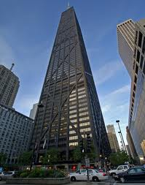
Proportion You try
The elevator that takes passengers from the lobby of the John Hancock Center in Chicago to the observation level travels 150 feet in 5 seconds. The observation level is located on the 94th floor, at 1029 feet above the ground.
Write the proportion of to solve the time it takes the elevator to travel from the lobby to the observation level.

Slide 19
A movie is filmed so that the ratio of the length to the width of the image on the screen is 1.85 to 1.
Write and solve a proportion to find the length of the image on the screen with the width of the image is 38 feet.
Make a table that shows the length of an image when the width of the image is 20, 25, 30, 35, and 40 feet. Use your table to check the reasonableness of your answer.

Slide 20
Homework
Pages 165 - 166
Problems ( 24, 26, 31, 32, 34, 40, 42, 47, 48, 49, 50, and 51)

