Slide 1
December 13, 2011
Solving Proportions Using Cross Product
Today is an A Day

Slide 2
Go Over Homework

Slide 5
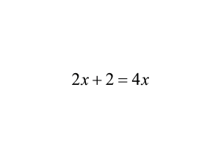
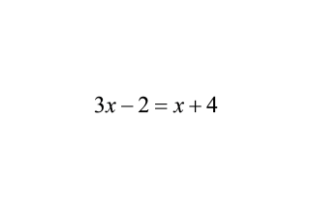
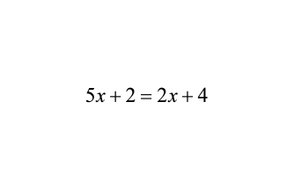
Warm-up
1.
2.
3.

Slide 6
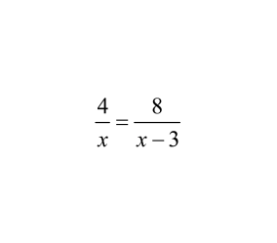
Example 1
Solve the proportion

Slide 7
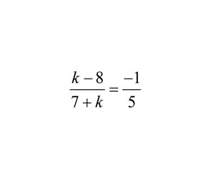
Example 2
Solve the proportion

Slide 8
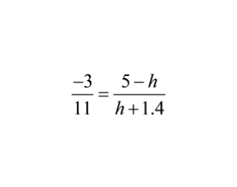
Example 3:
Solve the Proportion

Slide 9
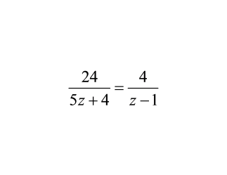
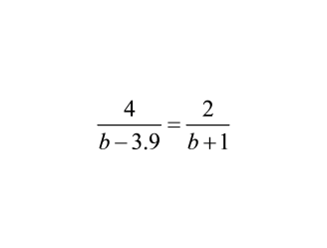
You try...Solve the proportions
1.
2.

Slide 10
Example 4 Use a scale to determine proportion
A map has a scale of 1 cm : 15 km. Use the given map distance to find the actual distance
1. 6 cm
2. 0.5 cm

Slide 11
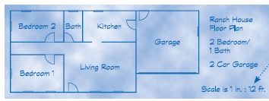
Example 5
Scale Drawings
The scale of a scale drawing or scale model relates the drawing's or model's dimensions and the actual dimensions.
Scale 6 in : 12 ft
Model (in inches) Real house (in feet)
Length x Width
Length x Width
Bedroom 1
Bedroom 2
Bath
Kitchen
Living Room
Garage

Slide 12
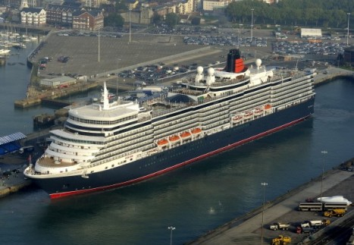
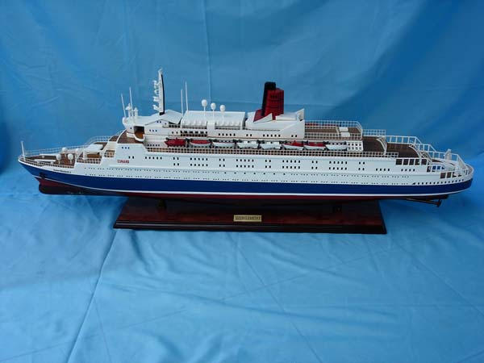
Example 6
The ship model kits sold at a hobby store have a scale of 1 ft : 600 ft. A completed model of the Queen Elizabeth II is 1.6 feet long. Estimate the actual length of the Queen Elizabeth II.

Slide 13
Group Activity
Jobs in Group for Problems:
READER--read problem out loud
SETTER --Set up proportion (with help)
CALCULATOR-- do calculations
CHECKER--Is answer reasonable?
Each person must complete their own worksheet

Slide 14
Homework
Pages 171 - 173
Problems (
24, 26, 28, 34, 36, and 39

