Slide 1
December 14, 2011
Applying Proportions to Similar Figures
Today is a B Day

Slide 2
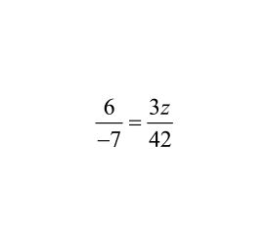
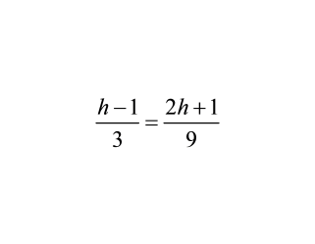
Warm-up
1.
The ratio of the length to the width of a rectangle is 5: 4. The length of the rectangle is 60 inches. What is the width?
2.
Solve the proportion.
3.
Solve the proportion.

Slide 4
Go Over Homework

Slide 7
Finish Group Activity
For Problems #7 and #8 Make sure you write on your worksheet the actual dimensions for each object.
For example, You should have the outside dimensions of the house as well as the windows and doors.

Slide 8
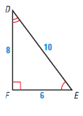
Similar figures have the same shape , but not necessarily the same size.
The symbol ~ represents similar
1. Corresponding angles of similar figures are congruent.
2. The ratios of the lengths of corresponding sides of similar figures are equal.

Slide 9
Are these similar?
D
A
B
C
F
E

Slide 10
How do we determine without SMART Board if they are similar?
D
A
7
8.75
4
5
B
C
F
E
2
3.5
A. Determine which sides are corresponding sides.
B. Set up corresponding proportions.
C. See if they are equal.

Slide 11
Other figures can be similar also.
E
1.33
F
A
1
B
1.5
1.5
2
2
D
C
2
H
G
2.67

Slide 12
Example 1: Are these Similar?
5
15
12
3
4
9
4
2
6
6
3
3
2.5
5

Slide 13
You try....Are these Similar?
E
1.
A
8
6
4.5
4
C
D
6
B
3
F
1.5
4
2.
6.7
3
3
6

Slide 14
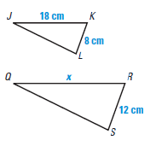
Example 2 Determing unknown segment

Slide 15
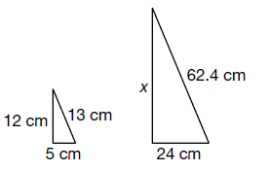
Example 3:
These two triangles are similar. Determine the value for x, the unknown side.

Slide 16
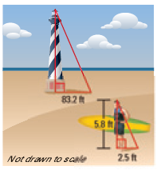
Example of Using Similar Figures to measure
A man stands next to the Cape Hatteras Lighthouse in North Carolina. The lighthouse and the man are perpendicular to the ground. The sun's rays strike the lighthouse and the man at the same angle, forming two similar triangles. Use indirect measurement to approximate the height of the lighthouse.

Slide 17
Example
You are building a ramp for your skateboard. You want the ramp to be 36 inches high. You have a ramp that is 56 inches long and 24 inches high. How many inches must you add to the length so that the ramp rises 36 inches?
36 in
24 in
56 in
x

Slide 18
Let's identify the similar segments of the triangles and then you try Problems 1 and 2.

Slide 19
Worksheet
Complete both sides of the worksheet.
Compare your answers with the other members of your group.
Discuss and resolve and differences.

Slide 20
Homework
Finish Worksheet (both sides)
Finish Group Activity

