Slide 1
December 15, 2011
Scale Drawing Activity (Colonial House)
Today is an A Day

Slide 2
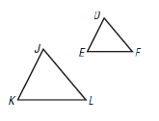
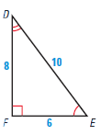
Warm-up
1.
Given
find x.
x
6
1
3
2.
Given
find x.
x
4
5
1
.75
3
3.
A figurine of a ballerina is based on a scale of 0.5 in : 4 in. If the real ballerina used as a model for the figurine is 68 inches tall, what is the height of the figurine?

Slide 3
Go Over Homework

Slide 4
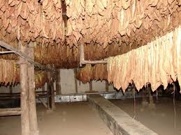
1. You will "become" a colonial person.
2. Based on your wealth (in tobacco), you will build a house.
3. You will need to use proportions to determine the cost of each item for your house.
4. On a loose leaf piece of paper, List all the details
A. Which option you chose for house stories
B. Which option you chose for the number of rooms
C. Each of the 9 other options
1) What you chose.
2) How you calculated your final amount based on
your house size.
Scale Drawing Activity
5. Answer all questions completely.
6. Draw a scale model of the floor plan.
7. Draw a picture of your house.

Slide 5
Homework
Complete Study Guide to Study for Test

