Slide 1
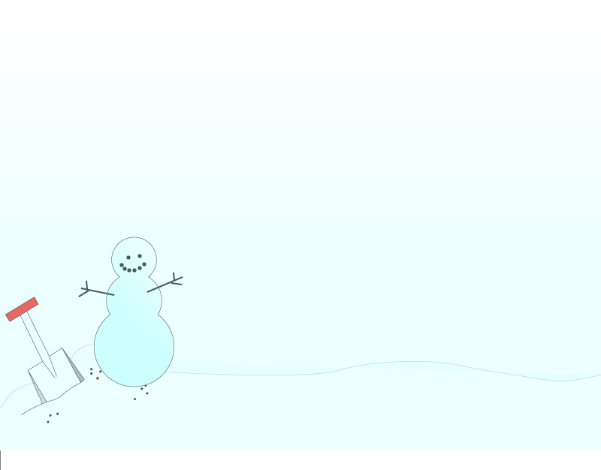
December 16, 2011
Review and Test
Today is a B Day

Slide 2
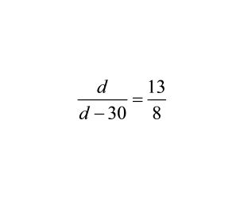
Warm-up
1.
A music downloading website reports that nearly 5 out of every 7 songs downloaded are classified as pop music. According to this information, predict how many of the next 500 songs downloaded will be pop songs. Round your answer to the nearest whole number.
2.
A map has a scale of 1 in : 38 ft. If two shops are 5.5 inches apart on the map, how far would you apart would you estimate them to actually be?
3.

Slide 3
Go Over Study Guide

Slide 4
Test

Slide 5
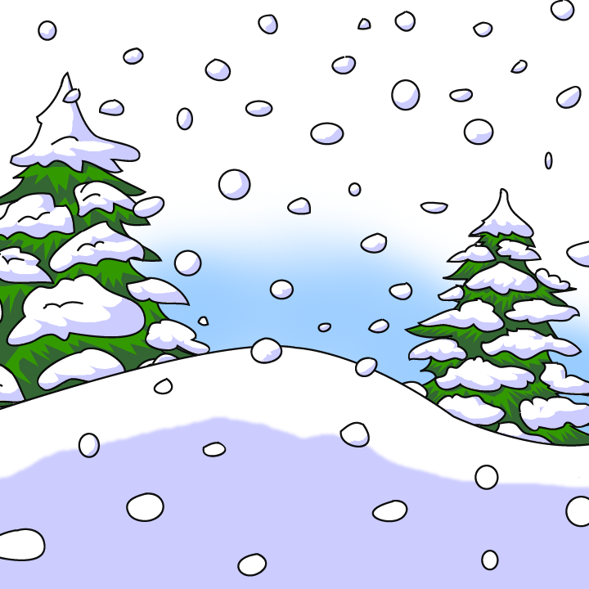
Homework
Have a wonderful winter vacation!!

