Slide 1
Algebra Comprehensive Honors
August 25, 2011
Today is a B day!

Slide 2
Warm-up:
Using yesterday's example, correctly put the title of today's lesson. (Use white board for help.)
Question: How many systems of measurement are present in the world? If there are more than one system, who uses which specific system?

Slide 3
Introduction to Conversions: (Pg. 956)
12 in = 1 ft
3 ft = 1 yd
1,760 yds = 1 mile
How many inches are in four miles?
In your groups, determine the correct solution. I will call on one person from each group to provide a reason for your solution.

Slide 4
Try this one on your own...
1000 milligrams (mg) = 1 gram (g)
1000 g = 1 kilogram (kg)
1000 kg = 1 metric ton (t)
How many milligrams equal 5 metric tons?
Show your work and be prepared to provide a reason for your solution.

Slide 5
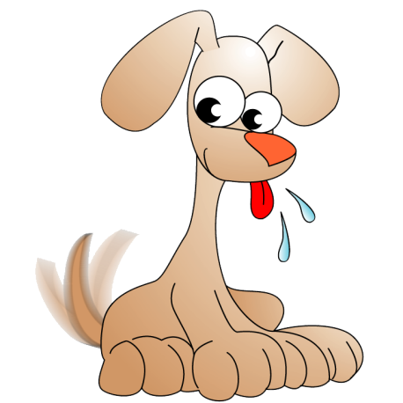
Applying Conversions to Real-World Situations:
In your group, determine the solution and provide evidence for your solution.
Veronica took her puppy, Jax, to the vet's office for his yearly check-up. During this time, the doctor wanted to weigh Jax to determine if he was in a healthy range. For Jax to be considered the appropriate size, his weight must be between 21-30 lbs. The scale was broken and would only provide Jax's weight in ounces (oz). Jax's weight was 448 ounces. Was Jax considered a healthy dog?

Slide 6
Applying Real-World Situations using Conversions:
Darnell was famous for his "crazy chili." The recipe was as follows and feeds 8 individuals.
2 pounds lean ground beef
1 (46 fluid ounce) can tomato juice
1 (29 ounce) can tomato sauce
1 (15 ounce) can kidney beans, drained and rinsed
1 (15 ounce) can pinto beans, drained and rinsed
1 1/2 cups chopped onion
1/4 cup chopped green bell pepper
1/8 teaspoon ground cayenne pepper
1/2 teaspoon white sugar
1/2 teaspoon dried oregano
1/2 teaspoon ground black pepper
1 teaspoon salt
1 1/2 teaspoons ground cumin
1/4 cup chili powder
He was put in charge of making enough 224 individuals attending a sports banquet. How many fluid ounces of tomato juice will he need? How many cups? How many pints? How many quarts? How many gallons?

Slide 7
Comparing Situations Using Conversions:
Joshua was riding a four wheeler at a rate of 12 feet per second. Marvin was skateboarding down the road at a rate of 5 miles per hour. Who was traveling at a faster rate? Why?

Slide 8
Homework:
Worksheet - Given in class

