Slide 1
Algebra Comprehensive Honors
August 26, 2011
BE PREPARED!
FOR
HURRICANE IRENE!

Slide 2
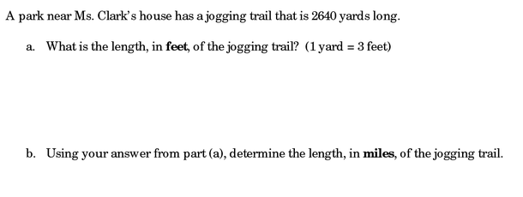
Warm-up:
Question:

Slide 3
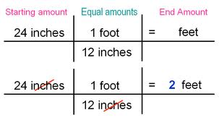
Converting Units using Dimensional Analysis
Problem-solving method that uses the fact that any number or expression can be multiplied by one without changing its value
Keyword
1. Dimensional analysis - using unit
analysis to help make conversions
from one unit to another.

Slide 5
Let's Try One!
360 inches = x yards
360 inches
x yards =

Slide 6
How many inches are in 2.5 yards?
x inches =

Slide 7
Convert 4 days to seconds
x seconds =

Slide 9
Pure silicon for use in computer chips costs 108 dollars an ounce, how much would 3.14 pounds cost?

Slide 10
Discuss with a partner why the first analysis works, but the second doesn't. Be able to explain.

Slide 11
AN EXAMPLE OF WHY THE FOREGOING IS IMPORTANT
Friday, October 1, 1999 LA Times
Mars Probe Lost Due to Simple Math Error
By ROBERT LEE HOTZ, Times Science Writer
Why it is so crucial to always double check your data entries and data manipulations.
NASA lost its $125-million Mars Climate Orbiter because spacecraft engineers failed to convert from English to metric measurements when exchanging vital data before the craft was launched, space agency officials said Thursday.
A navigation team at the Jet Propulsion Laboratory used the metric system of newtons and meters in its calculations, while Lockheed Martin Astronautics in Denver, which designed and built the spacecraft, provided crucial data in the English system of
inches, feet and pounds.
As a result, JPL engineers mistook readings measured in English units of poundseconds for a metric measure of impulse called newton-seconds. In a sense, the
spacecraft was lost in translation.
"That is so dumb," said John Logsdon, director of George Washington University's
space policy institute…

Slide 12
Start Video at 4:43
http://www.schooltube.com/video/12282e5df7434006aace/Unit-conversions-with-dimensional-analysis

Slide 13
Homework:
Using dimensional analysis ONLY!
Page 929
16-21

