Slide 1
Algebra Comprehensive
September 2, 2011
Today is an A day!

Slide 2
Warm-up:
Miguel and Samantha both jumped on a scale. Miguel weighed 110 pounds and Samantha weighed 95 pounds. Find the total weight of both Miguel and Samantha in ounces. Use dimensional analysis to determine your solution.
Title: Pythagorean's Theorem 9.2.11

Slide 3
FRIDAY TEST!!!!!!
Surprise!!!

Slide 4
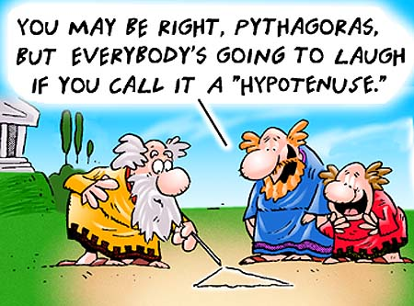
The life of Pythagoras
Born on the Island of Samos <Greece.htm> (off the coast of Asia Minor, not far from Miletus); his father was supposed to have been a gem-cutter or engraver. He left Samos in 530 to escape rule under Polycrates, a tyrant. He reportedly traveled in Egypt and Babylonia. Pythagoras later settled in Croton, on the Bay of Tarentum, in southern Italy, where there were Greek colonies.
He was a mathematician as well as a philosopher and a religious leader. He founded a philosophical/religious monastic order (the "Pythagoreans") of three hundred young men (reports differ as to whether the order included women; certainly, Pythagoras famously lectured to an all-women audience) that had strict rules of conduct and diet. They also held their property in common.

Slide 5
He believed that the study of mathematics could convert the soul from the world of the senses to the contemplation of the eternal. Pythagoras divided the soul from the soma (body) (which was considered the sema (prison)). The soul was immortal and transmigrated from one body to another (metempsychosis), including the bodies of other creatures (reincarnation). (According to one version of this theory, after leaving the human body, soul goes through all of the different animal bodies, which takes 3,000 years, before returning to a human body).
Today he is best remembered for Pythagoras' Theorem. It is believed that he did not write a book. There was an uprising in Croton against the Pythagoreans; many were killed and the rest were driven out. Pythagoras fled to a temple in the nearby town, Metapontum, where he starved to death.
Sometime close to his death or after the Pythagoreans divided into the akousmatikoi (from akousmata, "things heard"), who venerated his teachings on religion and the proper way to live but had little interest in philosophy and mathematics, and the mathematikoi (from mathema, "study" or "learning"), who were interested in philosophical, mathematical, musical, and astronomical knowledge. These three areas were connected, for they believed that mathematics was the key to understanding the kosmos: the kosmos is a harmonious (from harmonia, a carpenter's joint, and also a "musical fitting together") arrangement ordered by number.

Slide 6
Bronowski's Proof of the Pythagorean Theorem.
What did Pythagoras discover?

Slide 7
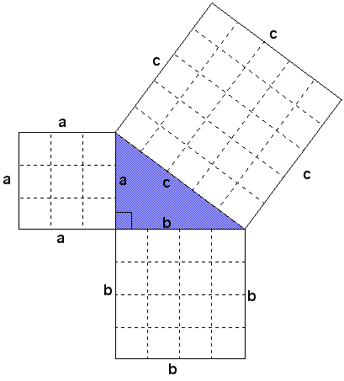
Groups:
What does this picture mean in relation to what we just discussed about Pythagorean's theorem.

Slide 10
Homework:
Activity 3.2 WS

