Slide 1
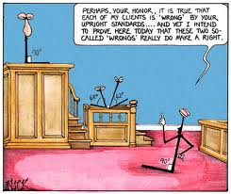
Algebra Comprehensive
September 9, 2011
Today is an A day!

Slide 2
Warm-up:

Slide 3
Review Guide
·Share Solutions in Group
·Discuss as Class

Slide 5
WEEKLY TEST!!

Slide 6
NO HOMEWORK!!!!

