Slide 1
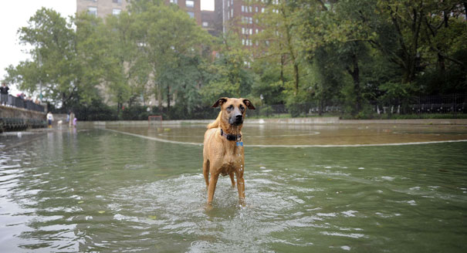
Welcome Back!!!
Hopefully you and your family had a safe weekend.
September 1, 2011

Slide 2
Warm-up:
Convert
16 cups = _____ quarts
800 ounces = ______ pounds

Slide 3
Homework Check: Pg. 971 (16-21)

Slide 9
Today will be the 8th Grade Diagnostic Test

