Slide 1
Algebra Comprehensive
September 13, 2011
Today is an A day!

Slide 2
Title: Order of Operations Date: 9.12.11
Warm-up:
-3x² - 6y + 2 - 4y + 3xy
Terms: ________________
Like Terms: ________________
Coefficients: ________________
Constants: ________________

Slide 3
Review Homework:

Slide 4
The order of operations are devised to provide a set way of doing the operations.
Grouping Symbols - ( ), [ ], { }
Exponents - x²
^{Mu}ltiplication/Division - from left to right.
Addition/Subtraction - from left to right.

Slide 5
Example: 27 ÷ 3² ∎ 2 - 3

Slide 6
Example 2: 3 [13 - (2 + 3)]²

Slide 7
What happens when you have a numerator and a denominator in your expression?
Example 3:

Slide 8
Try a few...
1.
2.
3.
4.

Slide 10
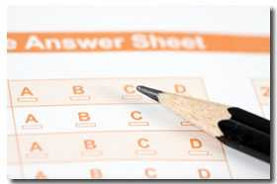
Part I of the Algebra Diagnostic

Slide 11
Homework:
Pgs. 10-12
6, 12, 19, 34, 35,

