Slide 1
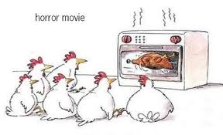
Algebra Comprehensive
September 14, 2011
Today is a B day!!

Slide 2
Warm-up:
Evaluate:
1.
2.

Slide 3
Review Homework

Slide 4
Evaluating algebraic expressions using the order of operations:
Example 1: 3x + 2(x - 6) * 2; when x = 3

Slide 5
Example 2: b³ - 21
5b + 9
; when b = 3

Slide 6
Example 3:
x² + 3x ; when x = 5
25

Slide 7
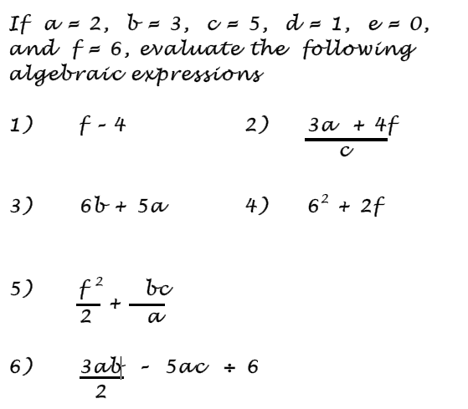

Slide 8
Homework:
Pgs. 11-12
22, 28, 29, 36, 38, 40

